Slide 1
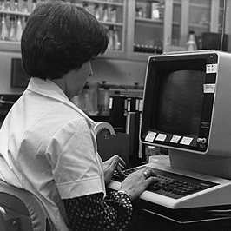
Second Generation computer
The replacement of vacuum
This Photo by Unknown Author is licensed under CC BY-SA

Slide 2
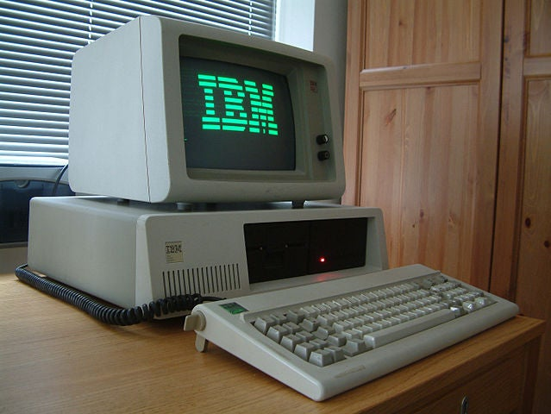
What the 1950s-1960s introduced
The second generation computers introduced the a new way of computing which paved a way for many other computers.
This IBM 7090 is a classical computer that was popular for scientific and engineering applications.
Second generation computers revolutionized the design and performance of computers.
This Photo by Unknown Author is licensed under CC BY-SA

Slide 3
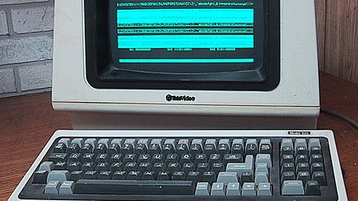
Key features and Technologies
This Photo by Unknown Author is licensed under CC BY-SA

Slide 4
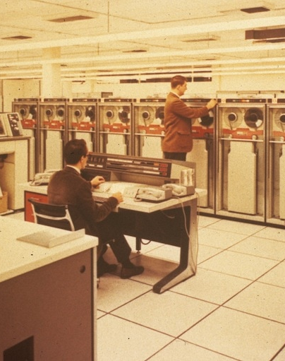
Features
Second-generation computers used magnetic cores for memory storage, which provided faster access times and improved data storage capacity.
The development of assembly languages enabled programmers to write code using symbolic representations, making programming more efficient and accessible.
Second generation computers marked the beginning of commercial computing , with tech companies developing and marketing computers for business applications.
This Photo by Unknown Author is licensed under CC BY-SA-NC

Slide 5
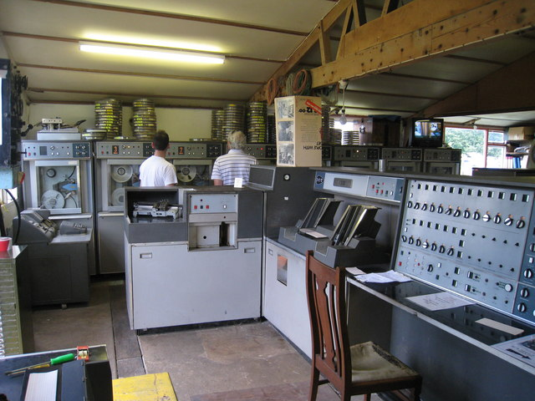
Impact on society
Improved performance, efficiency, and reliability.
Expanded applications in commercial. Scientific, and government sectors.
Societal benefits, such as job creation, economic growth, and improved healthcare and education.
This Photo by Unknown Author is licensed under CC BY-SA

Slide 6
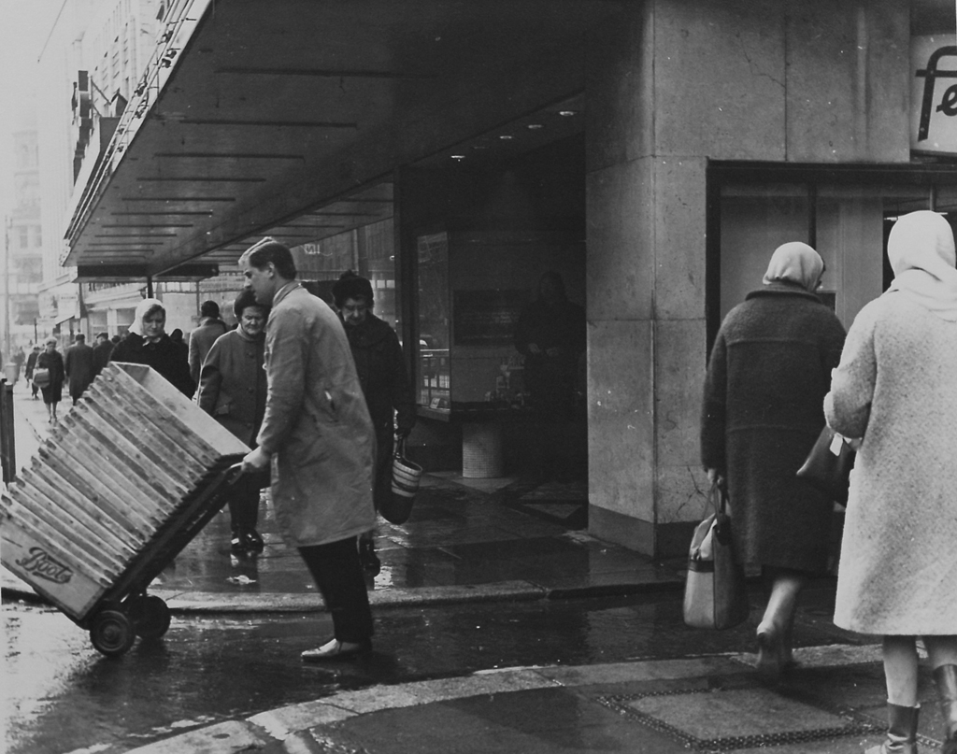
Summary
The second generation of computers, emerging in the 1950s and 1960s, marked a significant milestone in computing history. This era replaced vacuum tubes with transistors, leading to smaller, faster, and more reliable computers. Key features of second-generation computers included magnetic cores for memory storage, assembly languages for programming, and commercial computers for business applications. Examples included IBM 7090, UNIVAC 1107 and Honeywell 400. The transition to transistors paved the way for the development of third-generation computers and beyond, revolutionizing the computing industry and transforming the way people lived and worked.

